Slide 1
A Fresh Look at Comps
Hasan Haq

Slide 2
What are comps?
What are comps?

Slide 3
Implication [office space guy]

Slide 4
The Gameplan…
Target: EV / EBITDA Multiples
Features: Every financial metric available
The Tools:
BeautifulSoup / Selenium
Statsmodels / Sklearn

Slide 5
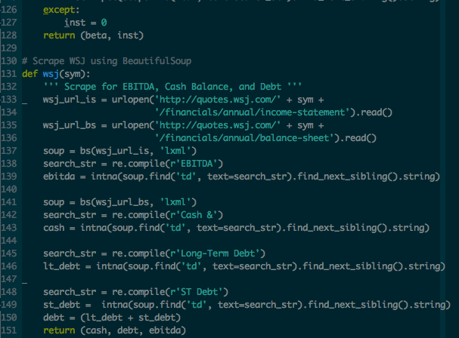
Scraping ain’t easy…
S&P 500
(and Russell 1000)
WSJ Website
SEC Website
Reuters Website
Morningstar API
Yahoo Finance API

Slide 6
Correlation Contemplation
32 Features
A few standout features
Analyst research “score”
R&D variable
“CEO Good
Dummies not yet included

Slide 7
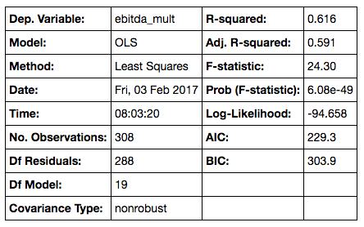
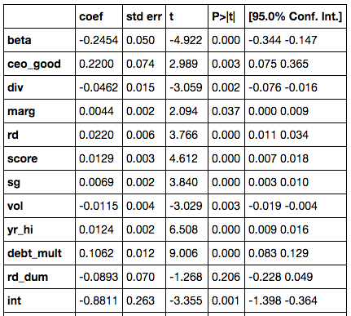
As Good As It’s Gonna Get… (?)
Sectors (not shown) matter a lot!

Slide 8
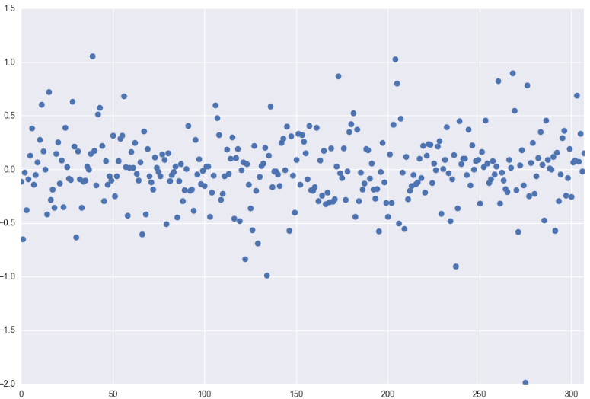
Ummm…

Slide 9
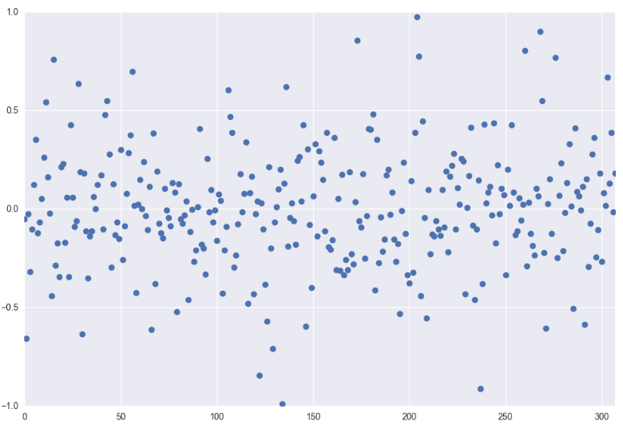
That’s Better!

Slide 10
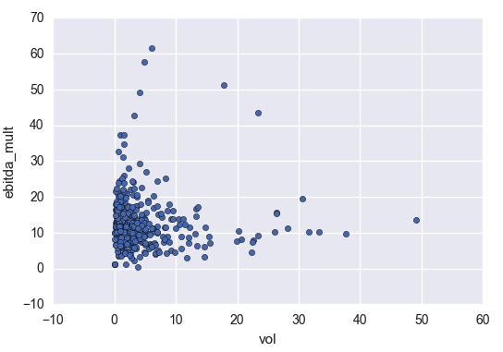
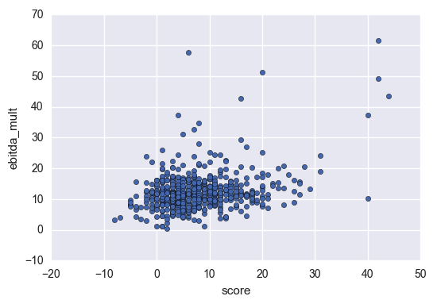
Pair Plots
Very small improvement with polynomial features

Slide 11
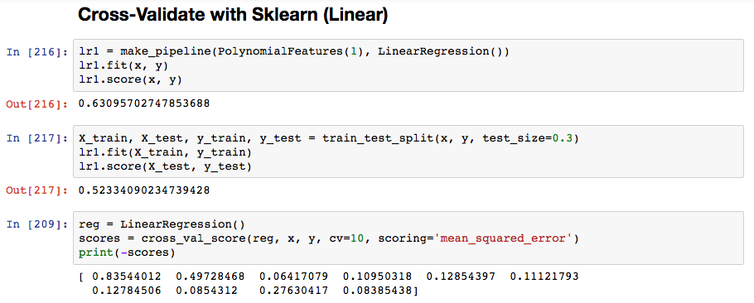
Cross-Validation (Linear)

Slide 12
Yee-haw!

Slide 13
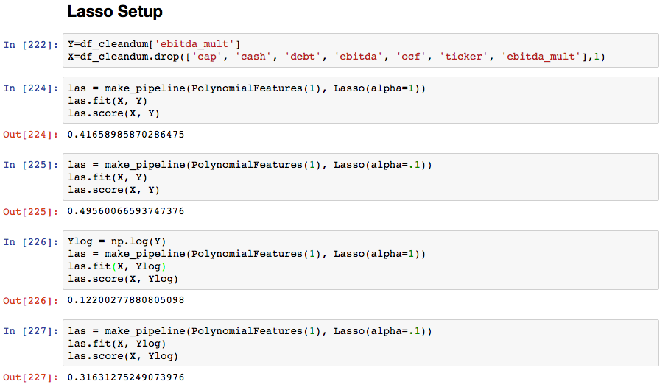
Take a step back… (Lasso)

Slide 14
Takeaways
The tried and true method is largely correct
Should look incorporate analyst research
Companies with R&D spending should be bucketed together
Companies with notable CEOs/management should be bucketed together

Slide 15
Areas to Improve
Scrub the Russell 1000 dataset
Focus on one industry
Evaluate more polynomial combinations
Look at more pairplots
Lasso and Ridge

